Slide 1


Laurent Klopfenstein
05/06/2024

Slide 2

Outline
Executive Summary
Introduction
Methodology
Results
Conclusion
Appendix

Slide 3
Executive Summary
Summary of methodologies
Data collection of SpaceX launch data
Data wrangling and exploratory data analysis (EDA)
Creation of an interactive dashboard to analyze launch records and of a map to visualize infrastructures in proximity to launch sites
Predictive analysis with the help of a machine learning model (classification)
Summary of all results
Features largely contributing to the success of launches are :
Localisation of a launch site
Payload mass
Booster version
Machine learning model with an accuracy of 83,3% on test data

Slide 4
Introduction
Project background and context
The commercial space age is here, companies are making space travel affordable for everyone
Several players are competing for this market but the most successful is SpaceX
SpaceX’s success comes from their lower/affordable prices which are achieved by reusing the first stage of their rockets, which drastically reduces their costs
The new company Space Y would like to enter the market and compete with SpaceX,
Problems and questions this project addresses
How much do reusable launches cost ?
What features help predict the outcome of a launch ?
Can the outcome of a launch be predicted with a model ?

Slide 5

Section 1

Slide 6
Methodology
Executive Summary
Data collection methodology:
Collection of relevant launch data via GET request to the SpaceX REST API and through web scraping of the “List of Falcon 9 and Falcon heavy launches” Wikipedia page
Data wrangling
Dataset filtered on Falcon 9 launches and addition of a landing outcome feature
Exploratory data analysis (EDA) using visualization and SQL
Interactive visual analytics using Folium and Plotly Dash
Predictive analysis using classification models
Performance evaluation of 4 models (Logistic regression, SVM, Decision Tree, KNN) on dataset to predict launch outcome

Slide 7




Data Collection
Datasets were collected through 2 sources :
SpaceX REST API calls
Web scraping the Falcon9 launches Wikipedia page
API
1.
Wikipedia
Local server
Dataset
2.

Slide 8
Data Collection – SpaceX API
How the SpaceX API works :
We ask for information by sending a HTTP GET request from our client to the SpaceX API endpoint (usage of requests library)
The SpaceX API endpoint sends a response back in the format of a json file
Because the information we need is scattered across several endpoints, to get a complete dataset, we must send a GET request to each endpoint individually. The endpoints are :
Past launches : https://api.spacexdata.com/v4/launches/past
Rockets : https://api.spacexdata.com/v4/rockets/
Launchpads : https://api.spacexdata.com/v4/launchpads/
Payloads : https://api.spacexdata.com/v4/payloads/
Cores : https://api.spacexdata.com/v4/cores/
GitHub link : Jupyter notebook - SpaceX API calls
GET request
SpaceX API endpoint
Client
Response in json format

Slide 9


Data Collection - Scraping
How the collection through scraping works :
We make a HTTP GET request to get the HTML page from the Wikipedia link we want to scrape as an HTTP response, with the requests library
With the response object we create a BeautifulSoup object which will allow us to parse the content of the response
We go through the different HTML elements of the Beautiful object to retrieve all relevant information which can be found in a Falcon 9 launches table and add these to our dataset
Wikipedia link : https://en.wikipedia.org/w/index.php?title=List_of_Falcon_9_and_Falcon_Heavy_launches&oldid=1027686922
GitHub link : Jupyter notebook - Web scraping
HTML
Wikipedia
HTML response
unstructured data
Parsing &
Retrieval of
relevant information
Structured data
added to dataset

Slide 10
Data Wrangling
Basic preliminary analysis of the content of the dataset
Missing values
Data type of the values in each column
Number of launches on each site
Number and occurrence of each orbit
Number and occurrence of mission outcome for each orbit
Using the Outcome feature, creation of an outcome label ‘Class’ to distinguish between successful and failed landings of the first stage of a rocket
GitHub link : Jupyter notebook - Data Wrangling

Slide 11
EDA with Data Visualization
To visualize the effect of the selected features on successful landing of the first stage, different charts have been drawn. You’ll find below the list of charts that’ve been used for analysis :
Scatter plot of :
Relationship between Payload Mass in kg and Flight Number with landing outcome
Relationship between Launch Site and flight number with landing outcome
Relationship between Payload Mass in kg and Launch Site with landing outcome
Relationship between Flight Number and Orbit type with landing outcome
Relationship between Payload Mass in kg and Orbit type with landing outcome
Other charts :
Bar chart of Landing outcome success rate per Orbit type
Line graph representing a yearly trend for Average Landing outcome success rate
GitHub link : Jupyter notebook - EDA with Data Visualization

Slide 12
EDA with SQL
SQL performed queries :
Display unique launch site names
Display records for which the launch site starts with ‘CCA’
Display total payload mass carried by boosters launched by NASA (CRS)
Display average payload mass carried by booster version F9 v1.1
Display the date when the first successful landing outcome on ground pad was achieved :
Display the names of the boosters which have had success in drone ship landing outcome and have a payload mass between 4000 kg and 6000 kg
Display the total number of successful and failed mission outcomes
Display the names of the booster_versions which have carried the maximum payload mass (15600 kg)
Display the month, landing outcome, booster version and launch site for records with a landing outcome failure for drone ship in year 2015
Display the count of landing outcomes between the date 2010-06-04 and 2017-03-20 ranked in descending order
GitHub link : Jupyter notebook - EDA with SQL

Slide 13
Build an Interactive Map with Folium
To find geographical patterns about launch sites, an interactive Folium map has been built with the data of the launch sites. Several objects were added to the map to better understand the location choice :
Markers of the location of the launch sites
Markers of successful/failed launches clustered together for each site
Distances between launch sites and their proximities – to help understand how the location of a launch sites is determined
GitHub link : Jupyter notebook - Folium interactive Map

Slide 14
Build a Dashboard with Plotly Dash
An interactive dashboard has been built with Dash so that users can examine information about launch sites, launches and their associated payload, and most importantly the outcome of the landings. The objective of the interactive components is to enable users to access and filter information based on their needs and to give them statistical data about launches and show how the chosen parameters influence the landing outcomes.
In the dashboard layout several components were implemented :
A dropdown list for launch site selection, with a default setting of combined information (”ALL”) or upon selection, individual information for launch sites (”CCAFS SLC-40”, “KSC LC-39A”, …)
A pie chart to show the total successful launches count for all sites. If a specific launch site was selected, the Success vs. Failed counts for the site are shown
A range slider to select an interval of payload mass in kg
A scatter chart to show the correlation between payload and launch success
Furthermore 2 callback functions were added for automatic update of the 2 graphical components upon input modification :
A callback function to render the pie chart based on the selection in the site dropdown
A callback function to render the scatter chart based on the payload interval selected in the range slider
GitHub links : Jupyter notebook - Dash app run Dash.py

Slide 15


















Predictive Analysis (Classification)
Data preprocessing
Separation of the dataset into 2 variables, one for the features called X and one for the target called Y (outcome of the landing called ‘Class’). In the end we want the model to be able to predict Y with the input of X.
We scale the features data using StandardScaler from sklearn.preprocessing library. This step ensures that the model is robust against the negative impact of extreme values (outliers) and a potentially skewed dataset on its accuracy.
Split of the dataset into training and test (i.e. validation) set with a split of 80/20. This is to assess the ability of the model to generalize and accurately predict results of an unknown test set after having been trained on our training data.
Testing of 4 different classification models to find the best performing one. This is done in 4 steps :
Creation of a model specific object
Create and fit a GridSearchCV object with the model and training data and test different parameter values to find the best ones
Calculate accuracy on the test data using the score method
Plot a confusion matrix
Compare the results of all the models to select the best performing model
X
Y
Scaler
Scaled X
Split
X_train
X_test
Y_train
Y_test
Model creation, fit with training data and GridSearchCV
Logreg
SVM
Tree
KNN
Scoring on test data
GitHub links : Jupyter notebook - Predictive Analysis
Score 1
Score 2
Score 3
Score 4
Best Model

Slide 16
Results
Exploratory data analysis results
Interactive analytics demo in screenshots
Predictive analysis results

Slide 17

Section 2

Slide 18
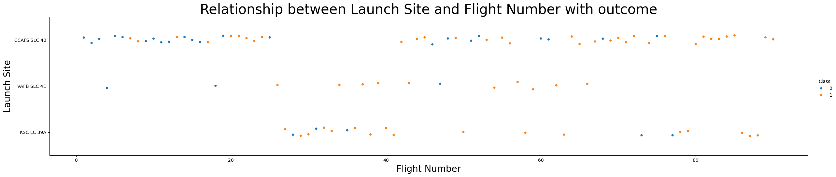
Flight Number vs. Launch Site
To visualize the effect of the selected features on successful landing, different scatter plots have been drawn. First, we tried to see if there was a relationship between the choice launch site and the outcome of each flight :
Observations :
Site CCAFS SLC-40 was being used almost exclusively in the 25 first launches, with little outcome success
CCAFS SLC-40 stopped being used between flight 25 and 40 and the other launch sites, VAFB SLC-4E & KSC LC-39A, showed promising outcome successes
From flight 40 and onwards CCAFS SLC-40 was predominantly used with an improved outcome success compared to the initial 25 flights, which can mean that either problems related to the launch site were fixed, or that technology in general was improved which resulted in better chances for landing success

Slide 19
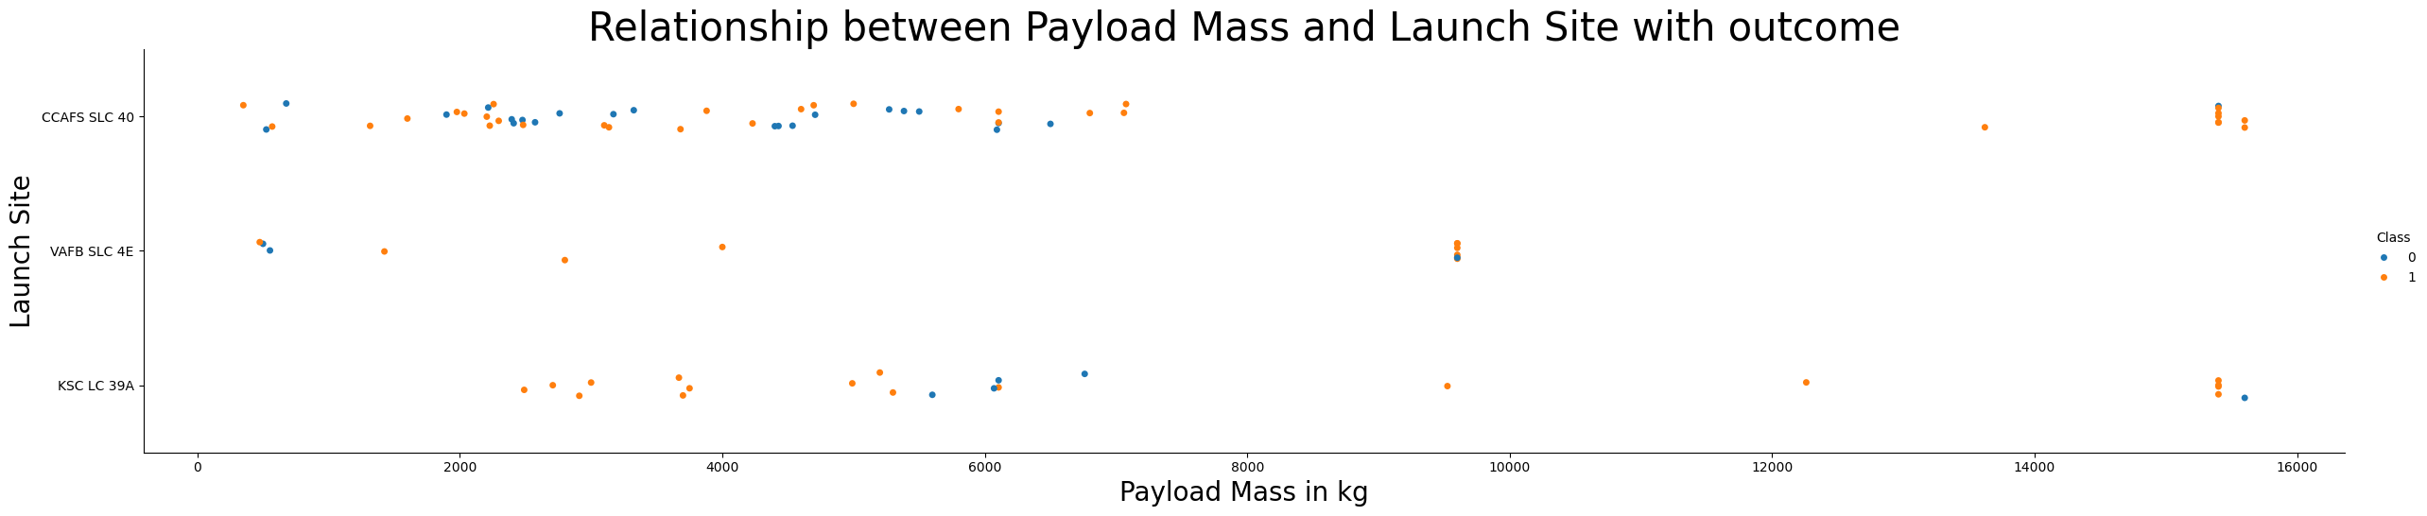
Payload vs. Launch Site
Payload mass and launch site seem to be correlated, but another feature might explain why some heavy launches are made exclusively at some launch sites, which points towards a differentiating feature between launch sites. Either VAFB SLC-40 doesn’t meet some requirements, for instance specific infrastructure needs or another feature influences this choice, for instance the type of Orbit.
If you observe the Payload mass vs. Launch Site chart you will find that for the VAFB-SLC launch site there are fewer launches and no rockets launched for heavy payload mass (greater than 10000).

Slide 20
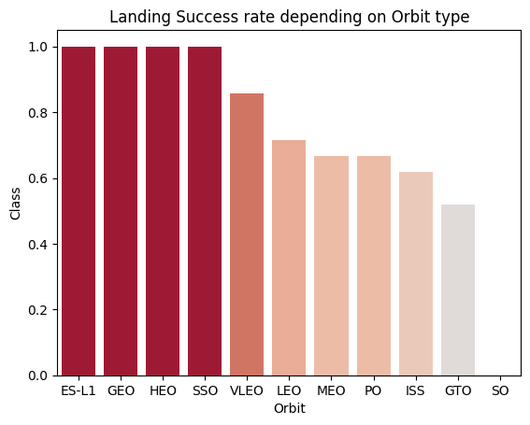
Success Rate vs. Orbit Type
Another factor seems to come into play when explaining landing success, which is Orbit type as we can see in the bar chart below :
Observations :
4 orbit types seem to have a perfect 100% success rate, which shows that some orbit types carry less/more risk for landing outcome
VLEO orbit type shows a high success rate around 85% success rate
4 orbit types compete in the same range of success rate around 60-70%
Finally, GTO’s success rate is the lowest at about 53%
We can infer that different orbit types carry different outcome success because they also have different starting requirements. For instance certain orbit types might require a specific launch site to be used, or a certain amount of payload to be used, which can augment the risk of landing failure for the first stage.

Slide 21
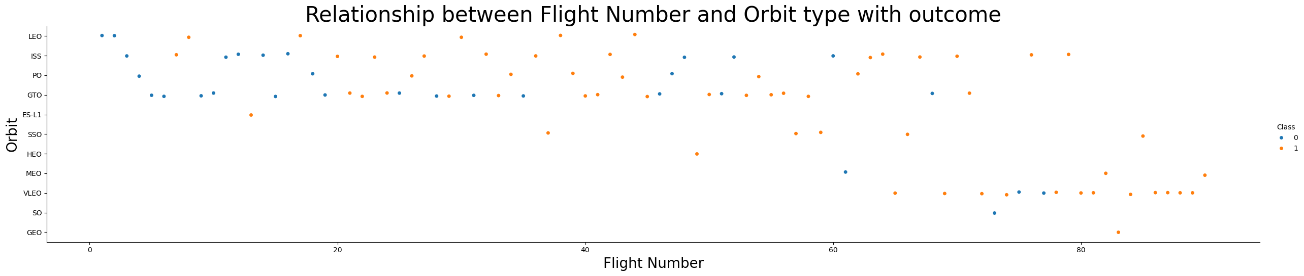
Flight Number vs. Orbit Type
Watching the relationship between flight number and orbit type unveils a trend over time (especially more recently) towards Very low Earth orbit (VLEO orbit type) launches.
Observations :
For the LEO orbit type the success appears to improve with the number of flights
On the other hand, quantity seems to have improved the success for the GTO orbit, but the outcome of a successful landing remains uncertain as is shown in the results of the flight before last of this orbit type

Slide 22
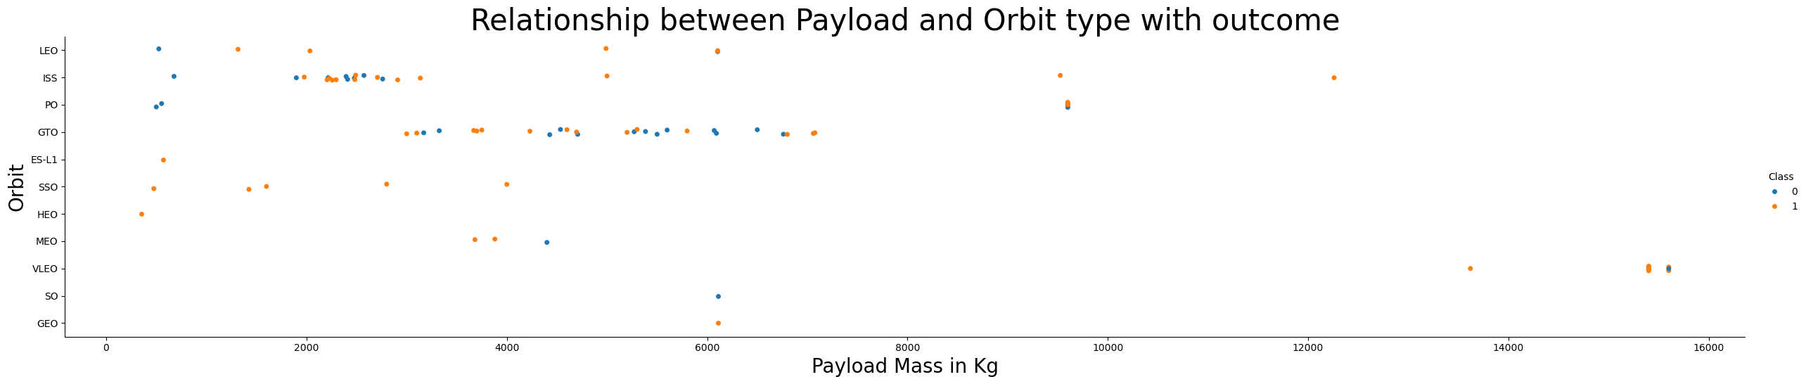
Payload vs. Orbit Type
The scatter chart for the relationship between payload and orbit type shows evidence for a positive correlation between the 2 features; each orbit type requires a certain amounts of payload and the higher the orbit, the bigger the payload.
Observations :
With heavy payloads the successful landing or positive landing rate are higher for Polar, LEO and ISS.
For GTO we cannot distinguish this clearly, as both positive landing rate and negative landing (unsuccessful missions) are both equally displayed for the same payload mass

Slide 23
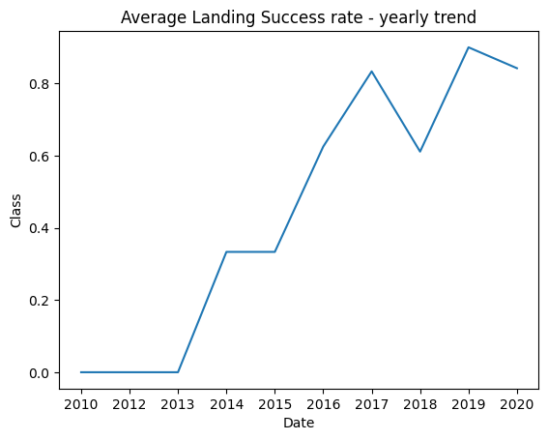
Launch Success Yearly Trend
With time (i.e. increasing flight number) success seems to have been drastically improved, starting from 2013.
Observations :
Over the first 3 years, no landing of the first stage was successful
After 2013 landing success rate has drastically been improved and has overall followed a positive/upward trend
A drop in success rate from ≈ 80% to ≈60% can be seen right around the time where launch site CCAFS LC-40 was employed again
Landing success reached an all-time high in 2019

Slide 24
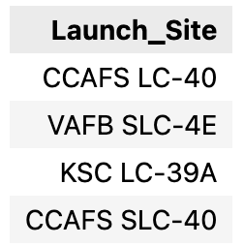
All Launch Site Names
SQL script :
SELECT DISTINCT Launch_Site FROM SPACEXTBL
Output :
Query explanation :
SELECT DISTINCT Launch_Site FROM SPACEXTBL : Select all DISTINCT (=unique) values in the column called Launch_Site from the table SPACEXTBL (FROM SPACEXTBL)
Launch Site information :
Cape Canaveral Space Launch Complex 40 (CCAFS SLC-40), sometimes pronounced Slick Forty and previously Cape Canaveral Launch Complex 40 (CCAFS LC-40) is a launch pad for rockets located at the north end of Cape Canaveral Space Force Station, Florida
Vandenberg Force Base Space Launch Complex 4 (VAFB SLC-4) is a launch and landing site at Vandenberg Space Force Base, California, U.S. It has two pads, both of which are used by SpaceX for Falcon 9, one for launch operations, and the other as Landing Zone 4 (LZ-4) for SpaceX landings.
Kennedy Space Center Launch Complex 39A (KSC LC-39A) is the first of Launch Complex 39’s three launch pads, located at NASA’s Kennedy Space Center in Merritt Island, Florida. The pad, along with Launch Complex 39B, was first constructed in the 1960s to accommodate the Saturn V launch vehicle, and has been used to support NASA crewed space flightmissions, including the historic Apollo 11 moon landing and the Space Shuttle.
(Source : en.wikipedia.org)

Slide 25
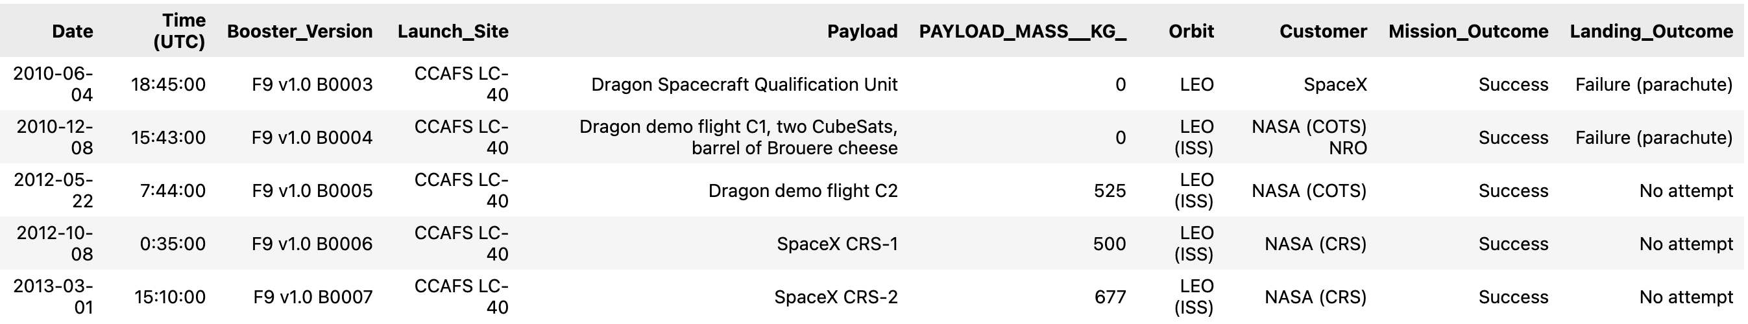
Launch Site Names Begin with 'CCA'
SQL script :
SELECT * FROM SPACEXTBL WHERE "launch_site" LIKE "CCA%" LIMIT 5
Output :
Query explanation :
SELECT * FROM SPACEXTBL : select all columns and associated values from the table SPACEXTBL (FROM SPACEXTBL)
Condition WHERE "launch_site" LIKE "CCA% » : Records must verify the condition that the values in column « launch_site » start with « CCA » and can end with anything else « % »
LIMIT 5 : Display only 5 records from the selection

Slide 26
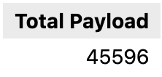
Total Payload Mass
SQL script :
SELECT SUM(PAYLOAD_MASS__KG_) AS "Total Payload" FROM SPACEXTBL WHERE "Customer" = "NASA (CRS)"
Output :
Query explanation :
SELECT SUM(PAYLOAD_MASS__KG_) AS "Total Payload" FROM SPACEXTBL : Select the sum of the values in the column called PAYLOAD_MASS_KG (SUM(PAYLOAD_MASS_KG) from the table SPACEXTBL (FROM SPACEXTBL) and name the resulting column « Total Payload » (AS « Total Payload »)
Condition WHERE "Customer" = "NASA (CRS) » : records must verify the condition of having the value « NASA (CRS) » in the Customer column

Slide 27
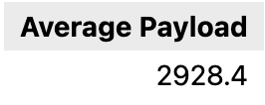
Average Payload Mass by F9 v1.1
SQL script :
SELECT AVG(PAYLOAD_MASS__KG_) AS "Average Payload" FROM SPACEXTBL WHERE "booster_version" = "F9 v1.1"
Output :
Query explanation :
SELECT AVG(PAYLOAD_MASS__KG_) AS "Average Payload" FROM SPACEXTBL : Select the average of the values in the column called PAYLOAD_MASS_KG (AVG(PAYLOAD_MASS_KG) from the table SPACEXTBL (FROM SPACEXTBL) and name the resulting column « Average Payload » (AS « Average Payload »)
Condition WHERE "booster_version" = "F9 v1.1" : records must verify the condition of having the value « F9 v1.1» in the « booster_version » column

Slide 28
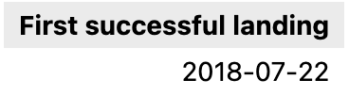
First Successful Ground Landing Date
SQL script :
SELECT MIN("Date") AS 'First successful landing' FROM SPACEXTBL WHERE "landing_outcome" = 'Success'
Output :
Query explanation :
SELECT MIN("Date") AS 'First successful landing' FROM SPACEXTBL : Select the smallest = earliest value of the values in the column called Date (MIN(« Date »)) from the table SPACEXTBL (FROM SPACEXTBL) and name the resulting column « First successful landing » (AS « First successful landing»)
Condition WHERE "landing_outcome" = 'Success' : records must verify the condition of having the value «Success» in the « landing outcome» column

Slide 29
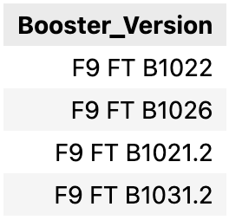
Successful Drone Ship Landing with Payload between 4000 and 6000
SQL script :
SELECT DISTINCT "booster_version" FROM SPACEXTBL WHERE ("payload_mass__kg_" BETWEEN 4000 AND 5999) AND ("landing_outcome" LIKE 'Success (drone ship)')
Output :
Query explanation :
SELECT DISTINCT "booster_version" FROM SPACEXTBL : Select all distinct (=unique) values in the column called « booster_version » (DISTINCT « booster_version ») from the table SPACEXTBL (FROM SPACEXTBL)
Condition 1 WHERE ("payload_mass__kg_" BETWEEN 4000 AND 5999) : records must verify the condition of having a value between 4000 and 6000 in the « payload_mass_kg » column
Condition 2 AND ("landing_outcome" LIKE 'Success (drone ship)’): records must verify the condition of having the value « Success (drone ship) » in the « landing_outcome » column

Slide 30
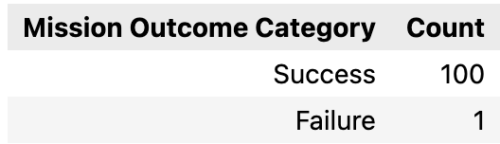
Total Number of Successful and Failure Mission Outcomes
SQL script :
SELECT CASE WHEN "mission_outcome" LIKE 'Success%' THEN 'Success' ELSE 'Failure' END AS 'Mission Outcome Category', COUNT(*) AS 'Count' FROM SPACEXTBL GROUP BY "Mission Outcome Category" ORDER BY 'Count' DESC
Output :
Query explanation :
SELECT CASE WHEN "mission_outcome" LIKE 'Success%' THEN 'Success' ELSE 'Failure' END AS 'Mission Outcome Category’ AS 'Mission Outcome Category' : Select values from column « mission_outcome » and modify them based on 2 cases. If values start with « Success% » then modify them into « Success » (CASE…. LIKE ‘Success%’), for anything else modify them into « Failure » (ELSE ‘Failure’ END); from the table SPACEXTBL (FROM SPACEXTBL) and call the resulting column ‘Mission Outcome Category’ (AS ‘Mission Outcome Category’)
And COUNT(*) AS 'Count' FROM SPACEXTBL : add a count of all above created values, either « Success » or « Failure » in a column called « Count »
GROUP BY "Mission Outcome Category" ORDER BY 'Count' DESC : group records by « Mission Outcome category » (GROUP BY « Mission Outcome Category ») and order them by value in column « Count » in descending order (ORDER BY ‘Count’ DESC)

Slide 31
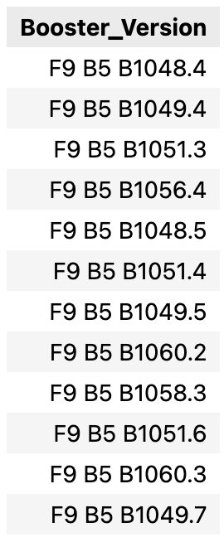
Boosters Carried Maximum Payload
SQL script :
SELECT Booster_Version FROM SPACEXTBL WHERE PAYLOAD_MASS__KG_ = (SELECT MAX(PAYLOAD_MASS__KG_) FROM SPACEXTBL)
Output :
Query explanation :
SELECT Booster_Version FROM SPACEXTBL : Select values from column Booster_Version from the table SPACEXTBL (FROM SPACEXTBL)
Condition with a nested select WHERE PAYLOAD_MASS__KG_ = (SELECT MAX(PAYLOAD_MASS__KG_) FROM SPACEXTBL) : condition that the selected values of booster_version must have a payload_mass_kg value equal (WHERE PAYLOAD_MASS_KG =) to the selection of the highest in the column PAYLOAD_MASS_KG from the SPACEXTBL (SELECT MAX(PAYLOAD_MASS_KG) FROM SPACEXTBL)

Slide 32
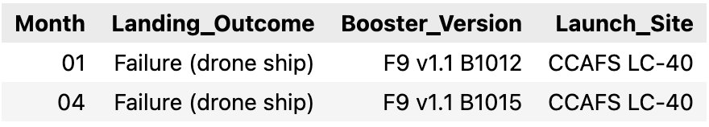
2015 Launch Records
SQL script :
SELECT substr(Date, 6,2) AS 'Month', "landing_outcome", "booster_version", "launch_site" FROM SPACEXTBL WHERE (substr(Date,0,5)='2015') AND ("landing_outcome" Like 'Failure%')
Output :
Query explanation :
SELECT substr(Date, 6,2) AS 'Month', "landing_outcome", "booster_version", "launch_site" FROM SPACEXTBL : Select from the values in column Date the characters starting at position 6 and stopping after 2 values (SELECT substr(Date, 6, 2) AS ’Month’) and call the resulting column Month. This will effectively extract the month of the Date values.
"landing_outcome", "booster_version", "launch_site" FROM SPACEXTBL : also select the columns « landing_outcome », « booster_version », « launch_site » from the table SPACEXTBL (FROM SPACEXTBL)
Condition 1 WHERE (substr(Date,0,5)='2015') : condition that the values at position 0 and going to position 5 are equal to « 2015 »
Condition 2 : AND ("landing_outcome" Like 'Failure%’) : condition that the values in column « landing_outcome » at minimum start with the word Failure (LIKE « Failure% »)

Slide 33
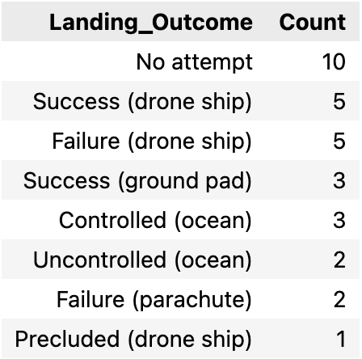
Rank Landing Outcomes Between 2010-06-04 and 2017-03-20
SQL script :
SELECT "landing_outcome", COUNT(*) AS 'Count' FROM SPACEXTBL WHERE "Date" BETWEEN DATE('2010-06-04') AND DATE('2017-03-20') GROUP BY "landing_outcome" ORDER BY Count DESC
Output :
Query explanation :
SELECT "landing_outcome", COUNT(*) AS 'Count' FROM SPACEXTBL : Select the column « landing_outcome » (SELECT « landing_outcome ») and create a column called Count of all records (COUNT(*) AS ‘Count’) from the table SPACEXTBL (FROM SPACEXTBL)
Condition WHERE "Date" BETWEEN DATE('2010-06-04') AND DATE('2017-03-20') : condition that the values in the column « Date » are in the date interval from 2010-06-04 to 2017-03-20
GROUP BY "landing_outcome » : group the records by the value that they have in column « landing_outcome »
ORDER BY Count DESC : order the values by descending order in the column Count

Slide 34

Section 3

Slide 35
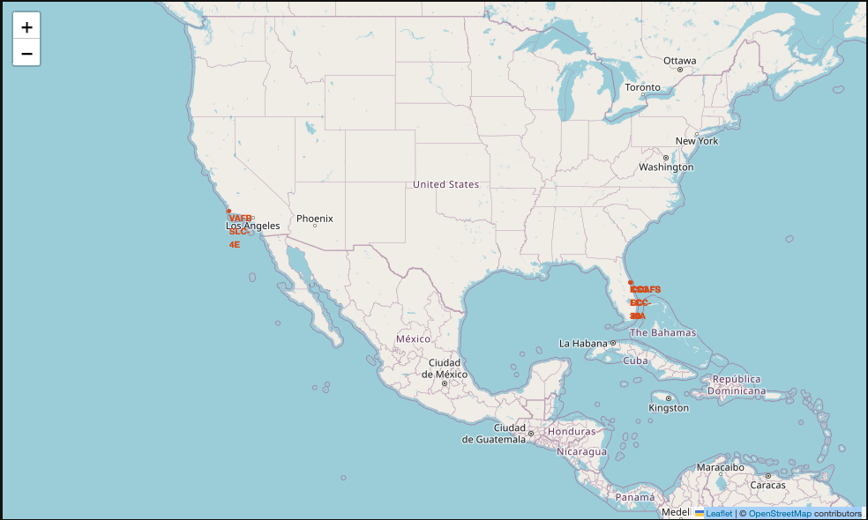
SpaceX Launch Sites Location
SpaceX’s uses 3 launch sites on the USA East coast and 1 on the West coast.
Because of the zoom of the screenshot, it is difficult to distinguish the 3 launch sites CCAFS LC-40, CCAFS SLC-40 and KSC LC-39A in Florida as they are only a few kilometers apart.
The fourth launch site, VAFB SC-4E is located in California.

Slide 36
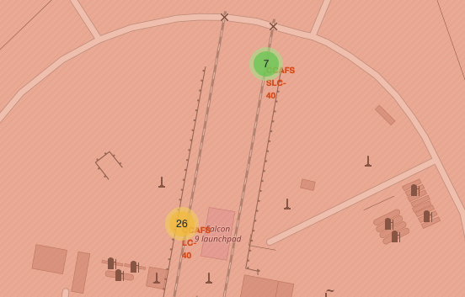
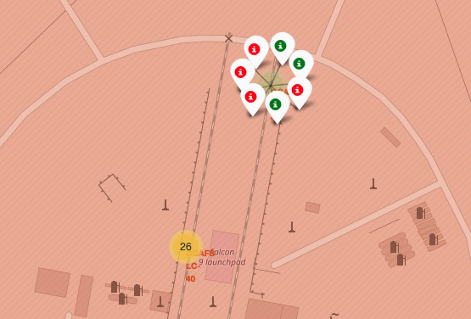
Color labeled Launch Outcome Markers
Color labeled markers have been added for each Launch Site
Markers for landing outcome success have been labeled green and for failure red
As outcome markers all share common locations (i.e., launch site locations to which they belong), they have voluntarily been grouped into marker clusters and only display when users click on the cluster
Marker clusters for launch site CCAFS SLC-40 (top)
and CCAFS LC-40 (bottom)
Color labeled markers for landing outcomes of launches from launch site CCAFS SLC-40

Slide 37
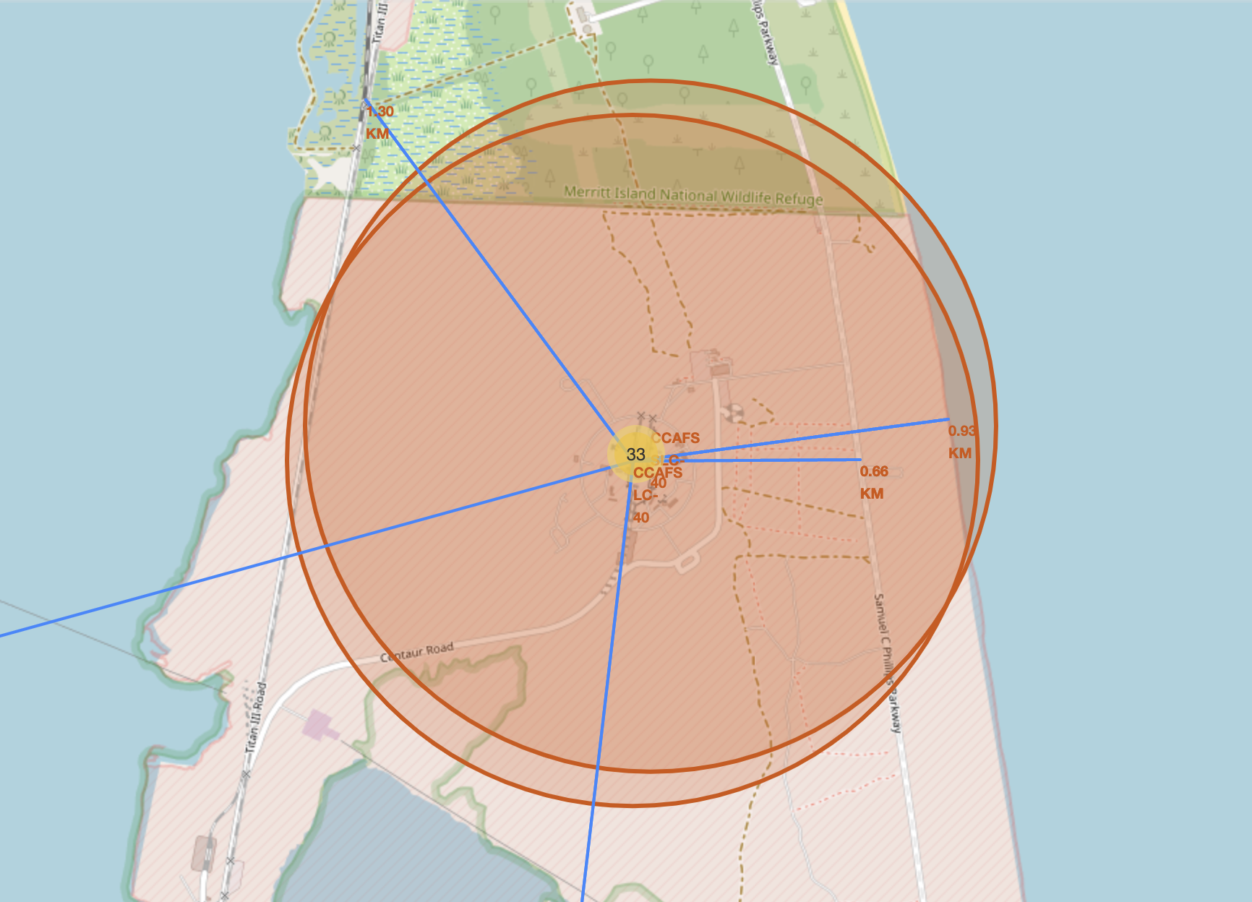
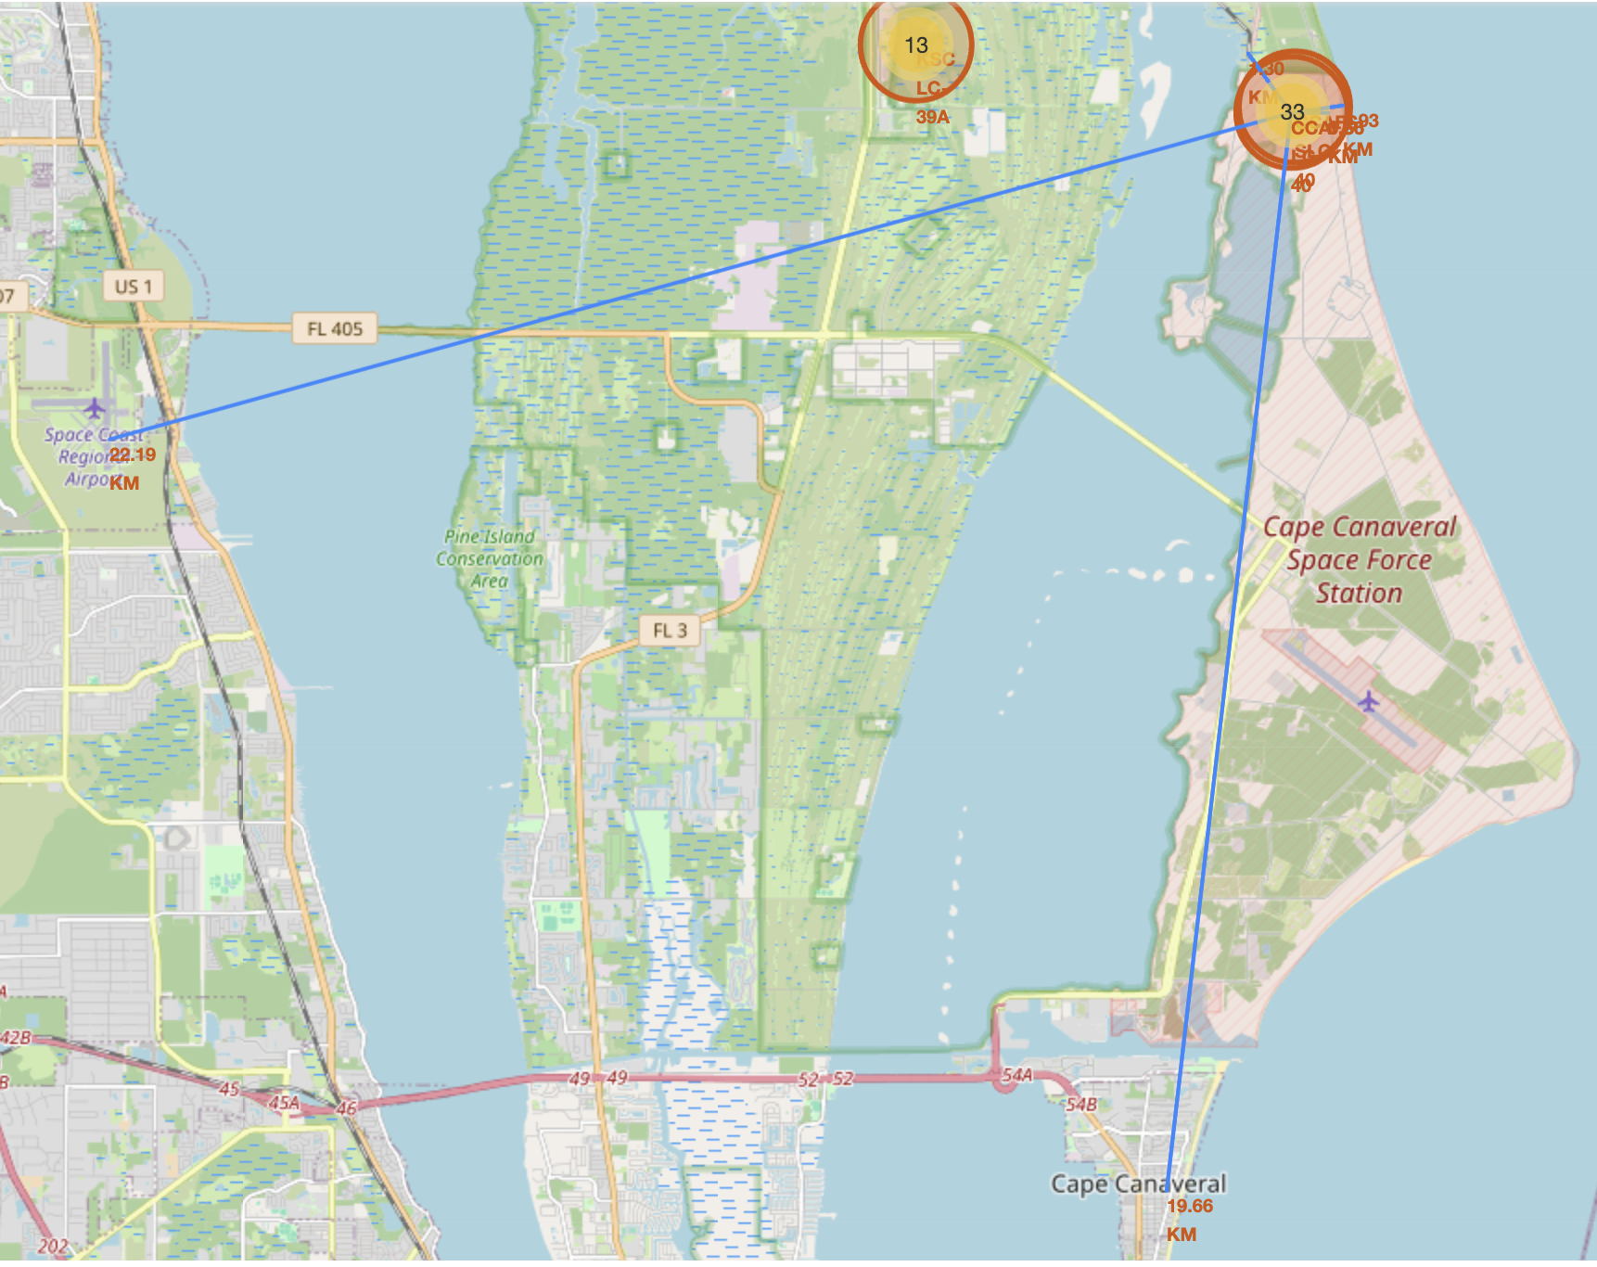
CCAFS SLC-40 location and proximities
CCAFS SLC-40 is located on the coast facing the Atlantic ocean at a distance of 0.9 km from water
The nearest highway is at a distance of 0.66 km
The nearest train railway is at a distance of 1.3 km
The nearest town is Cape Canaveral at a distance of 19.66 km
The nearest airport is at Space Coast Region airport at a distance of 22.19 km
We can deduce that launch sites need to be close to coast lines , with close access routes granted to launch sites (most likely for equipment supply) and that launch sites must be far enough from cities/airports to not disturb or endanger civils.

Slide 38

Section 4

Slide 39
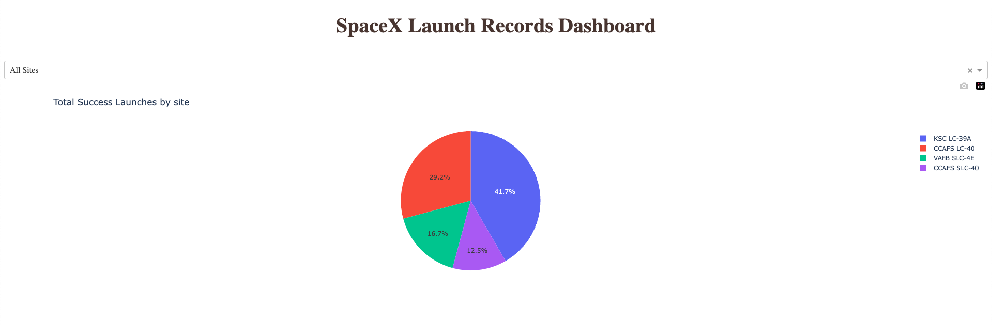
SpaceX Launch Records – Total successful launches
As displayed in the pie chart above, out of 24 successful launches :
KSC LC-39A has the biggest share of success with 41.7% of them (10 successful launches)
CCAFS LC-40 has a third of the success (7 successful launches)
VAFB SLC-4E and CCAFS SLC-40 both have similar share of 16.7% and 12.5%

Slide 40
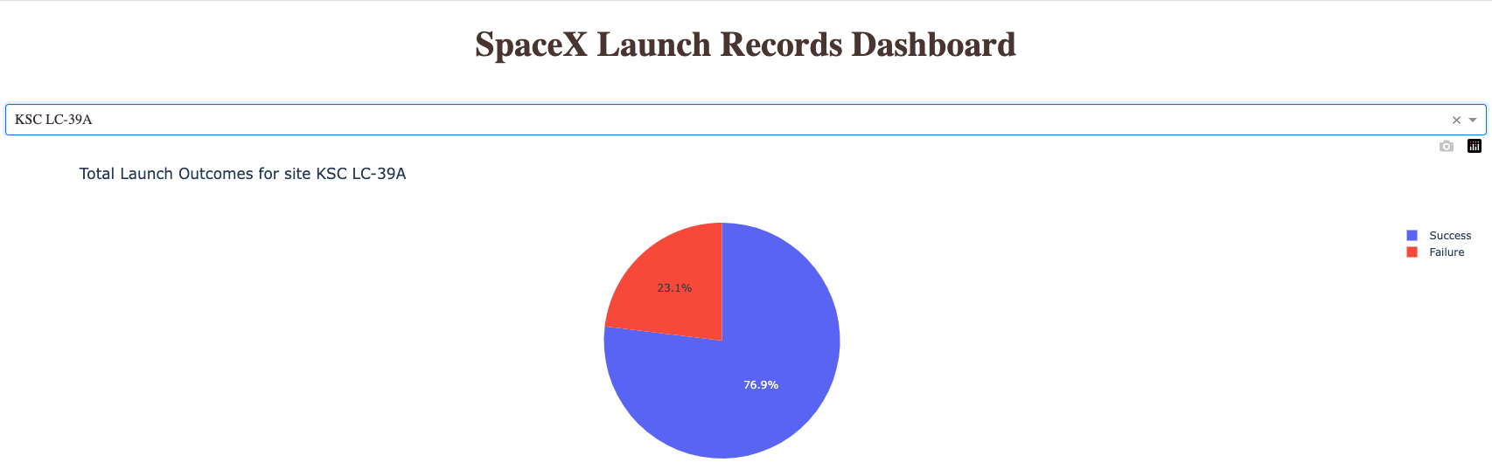
SpaceX Launch Records – KSC LC-39A launch outcomes
Explain the important elements and findings on the screenshot
The success rate of launch outcomes for launch site KSC LC-39A is of 76.9% meaning that only 1 in 4 launches has a failed outcome.
The total launch number for this launch site is of 13, meaning 10 successes and 3 failures.

Slide 41
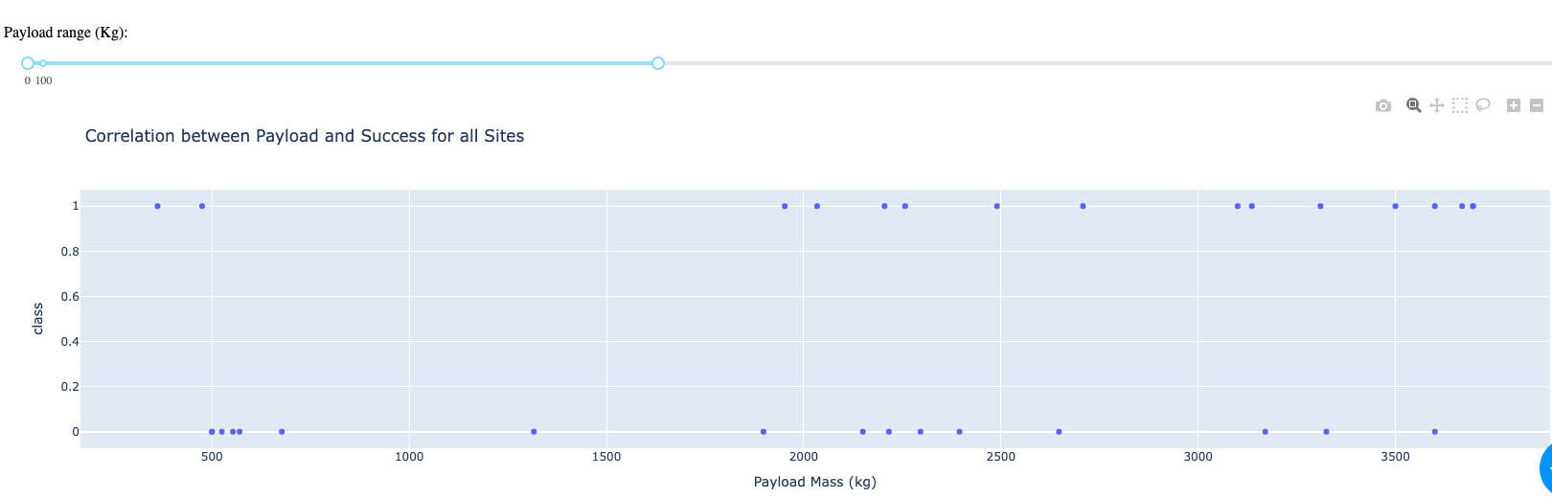
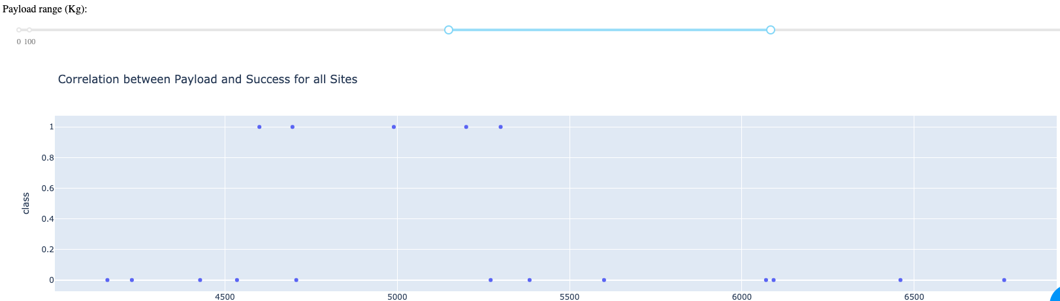
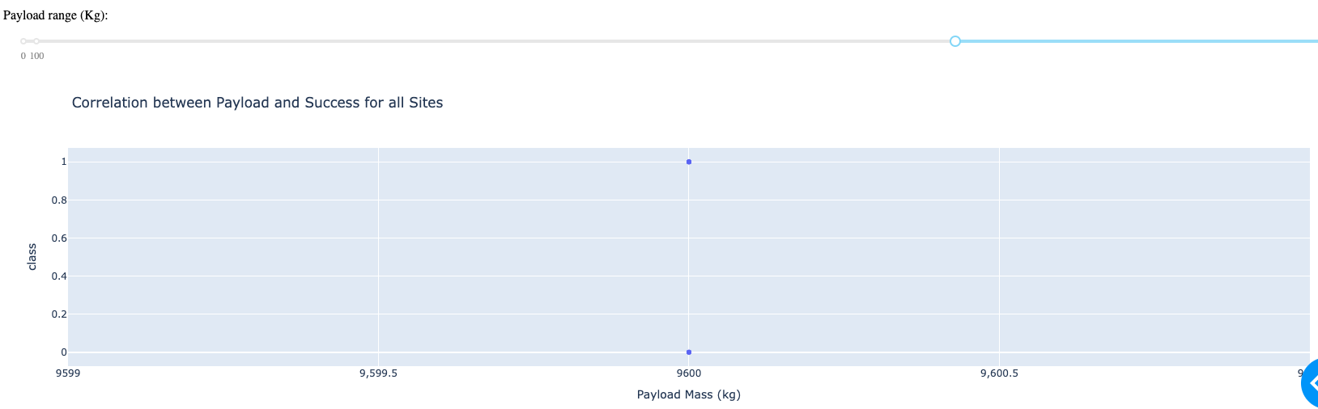
SpaceX Launch Records – Correlation between Payload and Success for all sites
Payload Mass < 4000 kg
Launches with a payload mass between 500 and 2000 kg seem to be completely unsuccessful
While launches with a payload mass between 2000 and 4000 kg seem to have a 50% chance of being successful
4000 < Payload Mass < 7000 kg
Launches with a payload mass between 4000 and 4500 kg and 5400 and 7000kg seem to be completely failing
While launches between 4500 and 5400 kg payload seem to be successful
Payload Mass > 7000 kg
We have data on only 2 launches with a payload over 7000kg in the dataset that we display
Since one was successful and the other one failed, we cannot really determine if this payload is riskier, as it currently has a 50/50 ratio

Slide 42

Section 5

Slide 43
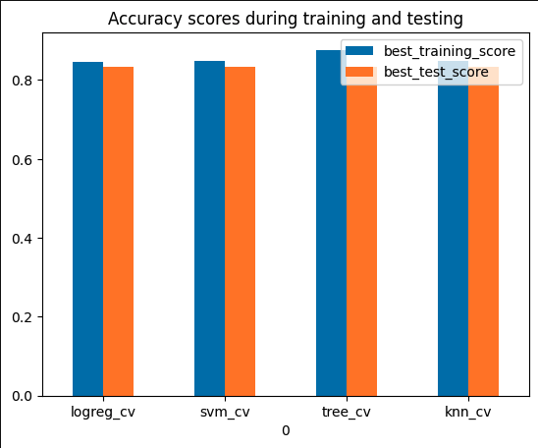
Classification Accuracy
The accuracy during testing for all 4 models is the same with a score of 83.3%
This a consequence of having a small dataset, the testing data consists of only 16 records and the optimized models seem to fair all equally on the test sample.

Slide 44

Confusion Matrix
We can see that in the displayed confusion matrix for the Tree_cv model we find :
12 TP
3 TN
3 FP
0 FN

Slide 45
Conclusions
Landing outcome for SpaceX’s launches is related to several features, but the main ones are, launch site location, payload mass in kg, orbit type and booster version
Over time the success rate of these launches has drastically improved which has played a big role in SpaceX’s commercial success as it reduced their cost function
SpaceX has been renting and using several launch sites, with different displays of success rate, KSC LC-39A being the most successful one
Overall launch sites share common attributes, being located on the coast and close to supply infrastructures like train railways and highway routes, but with enough distance to cities and airports that they wouldn’t disturb or endanger civilians
The model training and testing has been done on a very small dataset which makes it difficult for any of the tested models to prevail, however the choice was settled on Tree_cv which had the best training_score
With an accuracy of 83% on the test data, Tree_cv should be able to predict with high accuracy if launches will result in landing success of stage 1 for the rockets of company SpaceY

Slide 46
Appendix
Include any relevant assets like Python code snippets, SQL queries, charts, Notebook outputs, or data sets that you may have created during this project

Slide 47


